Slide 1

Agile Software Development
Module Number: 4
Agile Design Principles

Slide 2
Agile Software Development
        Syllabus
The Interface Segregation Principle (ISP): Interface Pollution, Separate Clients means Separate Interfaces, Class Interfaces versus Object Interfaces, The ATM User Interface Example,
Overview of UML for C# Programmers, Class Diagrams, Object Diagrams, Collaboration Diagrams, State Diagrams.

Slide 3
Agile Software Development
        AIM:
The aim of this module is to enable the students to create UML diagrams

Slide 4
Agile Software Development
        Objectives:
The Objectives of this Module is to:
Understand the concepts of Agile Principles related with Interface
Demonstrate the ideas through UML

Slide 5
Agile Software Development
        Outcomes:
At the end of this Module, Students will be able to:
Define Interfaces, and classes
Describe about Interface Segregation Principle
Create UML design

Slide 6
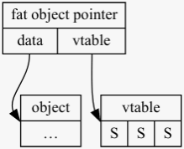
Agile Software Development
        The Interface Segregation Principle (ISP)
This principle deals with the disadvantages of “fat” interfaces.
Classes whose interfaces are not cohesive have “fat” interfaces.
The interfaces of the class can be broken up into groups of methods.
Each group serves a different set of clients.

Slide 7
Agile Software Development
        The Interface Segregation Principle (ISP) – Interface Pollution
Consider a security system in which Door objects can be locked and unlocked and know whether they are open or closed.
This Door is coded as an interface so that clients can use objects that conform to the Door interface without having to depend on particular implementations of Door.
public class Timer
{
public void Register(int timeout, TimerClient client)
{/*code*/}
}
public interface TimerClient
{
void TimeOut();
}
public interface Door
{
void Lock();
void Unlock();
bool IsDoorOpen();
}

Slide 8
Agile Software Development
        ‘Separate Clients’ means ‘Separate Interfaces’
Door and TimerClient represent interfaces that are used by completely different clients.
Timer uses TimerClient, and classes that manipulate doors use Door.
Since the clients are separate, the interfaces should remain separate.
Amitab Bachhan Amitab Bachhan
  Firstcry.com Policy Bazaar.com
  English Hindi

Slide 9
Agile Software Development
        ‘Separate Clients’ means ‘Separate Interfaces’
Door and TimerClient represent interfaces that are used by completely different clients.
Timer uses TimerClient, and classes that manipulate doors use Door.
Since the clients are separate, the interfaces should remain separate.
Amitab Bachhan Amitab Bachhan
  Firstcry.com Policy Bazaar.com
  English Hindi

Slide 10
Agile Software Development
        Classes vs. Interfaces
Classes
  A class describes the attributes and behaviors of an object.
  A class may contain abstract methods, concrete methods.
Interfaces
  An interface contains behaviors that a class implements.
  An interface contains only abstract methods.
Class Interface
  The interface to a class is its "public face" that other classes can see.
  It separates the class's implementation from the way it interacts with other classes

Slide 11

Agile Software Development
        Class Interfaces vs. Object Interfaces
Amitabh Bachhan
  Firstcry.com
    English
    Telugu
Abhisekh Bachhan
  Idea Cellular
    English
    Telugu

Slide 12
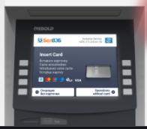
Agile Software Development
        The ATM User Interface

Slide 13
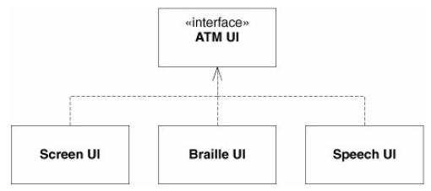
Agile Software Development
        ATM User Interface
Screen UI
  ATM Card with PIN Number
Braille UI
  ATM Card with PIN (Touch Identification)
Speech UI
  ATM Card with PIN (Voice Input)

Slide 14
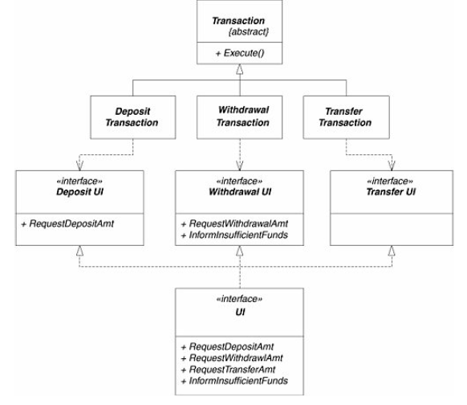
Agile Software Development
        ATM User Interface
Deposit
  Deposit Interface
    CDM
    In Person in Bank
Withdraw
  Withdraw Interface
    ATM Machine
    POS
    In Person in Bank
Transfer
  Transfer Interface
    NEFT / RTGS
    IMPS

Slide 15
Agile Software Development
        Overview of UML
The Unified Modeling Language (UML) is a graphical notation for drawing diagrams of software concepts.
  Class Diagrams
  Object Diagrams
  Collaboration Diagrams
  State Diagrams
  Use Case Diagrams
  Sequence Diagram

Slide 16
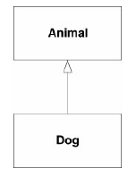
Agile Software Development
        Overview of UML - More
Why UML?
  The goal of UML diagrams is to allow teams to visualize how a project is or will be working.
  Example:
    A dog is an animal
  Coding Example:
    public class Animal { }
    public class Dog : Animal
    { }

Slide 17
Agile Software Development
        Class Diagram
Definition:
  It describes the structure of a system by showing the system's classes, their attributes, operations (or methods), and the relationships among objects.
  Components of Class Diagrams
    1. Rectangles represent classes
    2. Arrows represent relationships
    3. Class Icon
    4. Interface Icon

Slide 18
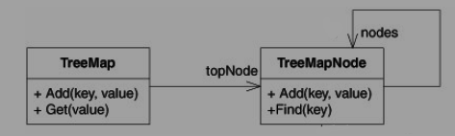
Agile Software Development
        Class Diagram Example

Slide 19
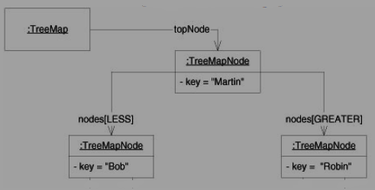
Agile Software Development
        Object Diagram
Definition:
  Object diagram contains set of objects and properties (relationships) during the execution of the system.

Slide 20
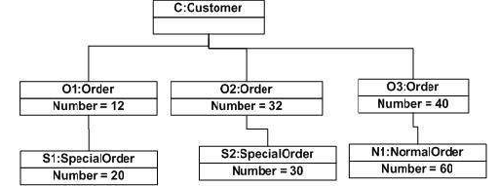
Agile Software Development
        Object Diagram(more)
Definition:
  Object diagram contains set of objects and properties (relationships) during the execution of the system.
  Rectangle indicates Objects
  Relationships are denoted with Links
  Object names are underlined

Slide 21
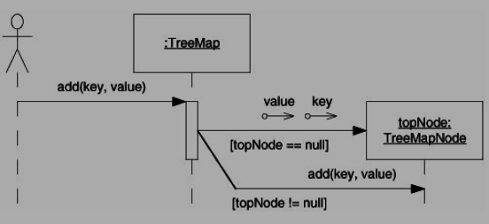
Agile Software Development
        Sequence Diagram
Definition:
  The process flow between the system is denoted in sequence diagram
  Login
  Adding Nodes
  Deleting Nodes
  Searching Nodes

Slide 22
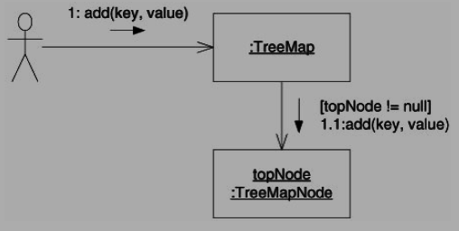
Agile Software Development
        Collaboration Diagram
Definition:
  Collaboration diagrams contain the same information that sequence diagrams contain
  However, whereas sequence diagrams make the order of the messages clear, collaboration diagrams make the relationships between the objects clear.

Slide 23
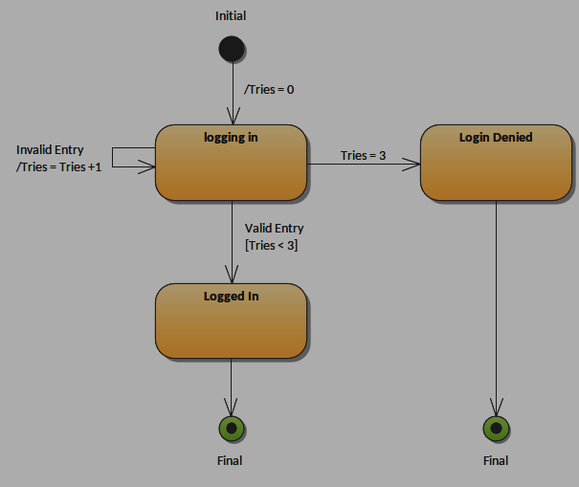
Agile Software Development
        State Diagram
Definition:
  State diagrams are extremely useful for figuring out the way a system behaves.

Slide 24
Agile Software Development
        Summary
  The Interface Segregation Principle (ISP): Interface Pollution, Separate Clients means Separate
  Interfaces, Class Interfaces versus Object Interfaces,
  The ATM User Interface Example,
  Overview of UML for C# Programmers,
  Class Diagrams : Class diagrams are the blueprints of your system or subsystem
  Object Diagrams : Used to render a set of objects and their relationships as an instance.
  Collaboration Diagrams : Used to show the relationship between the objects in a system
  State Diagrams : used to give an abstract description of the behavior of a system

Slide 25
Self Assessment Questions & Assignment - 4

Slide 26
Agile Software Development
        Self Assessment Question
1. ‘FAT’ Interfaces are dealt by,
      Interface Segregation
      Interface Defining
      Interface Explanation
      Interface Deriving
      Answer: A. Interface Segregation

Slide 27
Agile Software Development
        Self Assessment Question
2. Mandatory Class diagram parts are,
      Class name, attributes
      Attributes, Functions
      Class name, Functions
      Attributes, Objects
      Answer: C. Class name, Functions

Slide 28
Agile Software Development
        Self Assessment Question
3. Which diagram in UML shows a complete or partial view of the structure of a modeled system at a specific time?
      Class Diagram
      Object Diagram
      Sequence Diagram
      State Diagram
      Answer: D. State Diagram

Slide 29
Agile Software Development
        Self Assessment Question
4. Which of the following diagram is time oriented?
      Sequence Diagram
      Class Diagram
      State Diagram
      Sequence Diagram
      Answer: A. Sequence Diagram

Slide 30
Agile Software Development
        Self Assessment Question
5. Which diagram is used to show interactions between messages are classified as?
      Object Diagram
      Collaboration Diagram
      Class Diagram
      Sequence Diagram
      Answer: B. Collaboration Diagram

Slide 31
Assignment - 4

Slide 32
Consider your Assignment-1,
(1) Draw the Class diagram for any one module
(2) For the same module draw the Sequence diagram
(3) For any single operation draw the State Diagram

Slide 33
Agile Software Development
        Document Link
Topic | URL | Notes
Times New Roman-14PT | https://www.scaledagileframework.com/refactoring/ | Times New Roman-14PT
Times New Roman-14PT | Times New Roman-14PT | Times New Roman-14PT
Times New Roman-14PT | Times New Roman-14PT | Times New Roman-14PT

Slide 34
Agile Software Development
        Video Link
Topic | URL | Notes
Times New Roman-14PT | Times New Roman-14PT | Times New Roman-14PT
Times New Roman-14PT | Times New Roman-14PT | Times New Roman-14PT
Times New Roman-14PT | Times New Roman-14PT | Times New Roman-14PT

Slide 35
Agile Software Development
        E- Book Link
Ebook name | Chapter | Page No. | Notes | URL
Times New Roman-14PT | Times New Roman-14PT | Times New Roman-14PT | Times New Roman-14PT | Times New Roman-14PT
Times New Roman-14PT | Times New Roman-14PT | Times New Roman-14PT | Times New Roman-14PT | Times New Roman-14PT

Slide 36
Thank you ALL!

